Slide 1
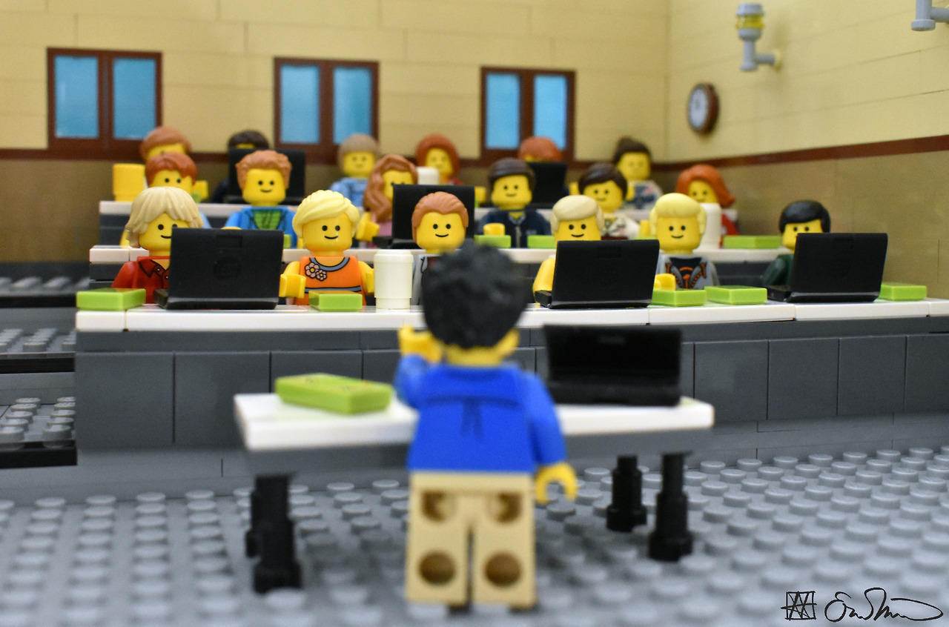
FOSS 101
Sarah Glassmeyer
Project Specialist Manager,
ABA Center for Innovation
@sglassmeyer / sarah.glassmeyer@americanbar.org
https://legogradstudent.tumblr.com/image/166259076546

Slide 2
DISCLAIMER: I do not speak for the American Bar Association (ABA). The ABA doesn’t endorse or acknowledge anything I say here today. The only people allowed to speak for the ABA are the ABA President and his/her designees, which I am not.

Slide 3

Photo CC BY-NC-SA https://www.flickr.com/photos/reiterlied/
Notes:
I’m not a lawyer, but I am

Slide 4
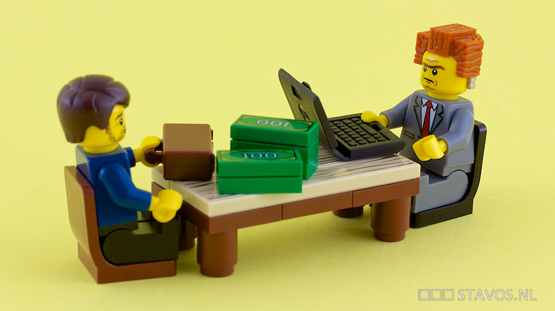
Photo CC BY-NC-ND 2.0 https://www.flickr.com/photos/stavos52093/
Notes:
I was wondering if I would be the first one in the legal tech conference bingo card to drop the stat that 86% people who need a lawyer or legal services. It’s a multi pronged problem and there’s a lot of reasons, but the inability of people to afford an attorney and on the flip side, the inability of attorneys to charge an affordable cost and still live is a big part.
Legal tech is a 16 billion dollar market.

Slide 5
Open

Slide 6
What and Why?

Slide 7
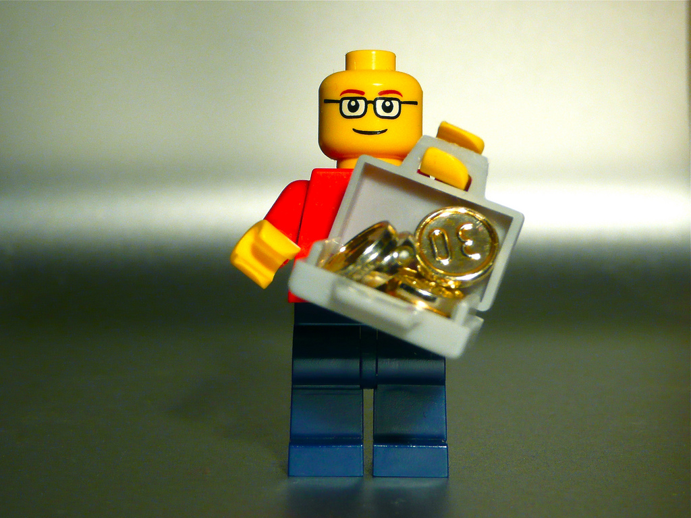
Photo CC BY-NC-SA 2.0 https://www.flickr.com/photos/ntr23/
Notes:
Monetary cost is just part of it

Slide 8
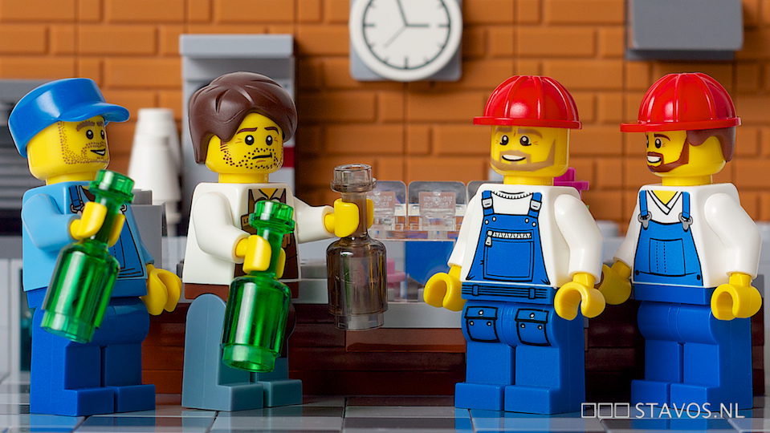
Photo CC BY-NC-ND 2.0 https://www.flickr.com/photos/stavos52093/
Notes:
Free as in beer

Slide 9
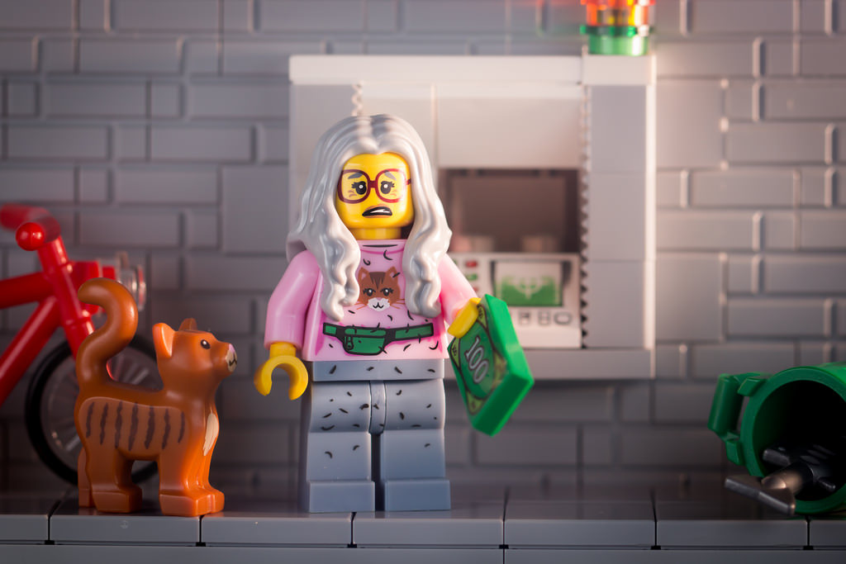
Photo CC BY-NC-ND https://www.flickr.com/photos/clement127/
Notes:
FREE AS IN KITTENS

Slide 10
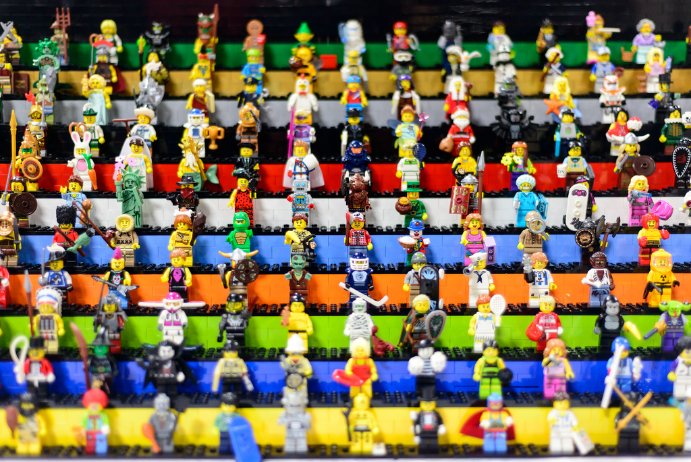
Photo CC BY-NC-SA https://www.flickr.com/photos/ejpphoto/
Notes:
Community built and supported

Slide 11
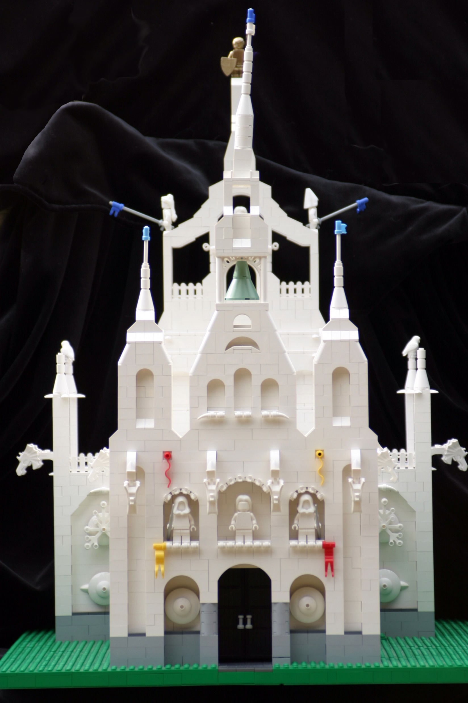
Photo CC BY NC ND https://www.flickr.com/photos/10279741@N00/
Notes:
Cathedral and Bazzar

Slide 12
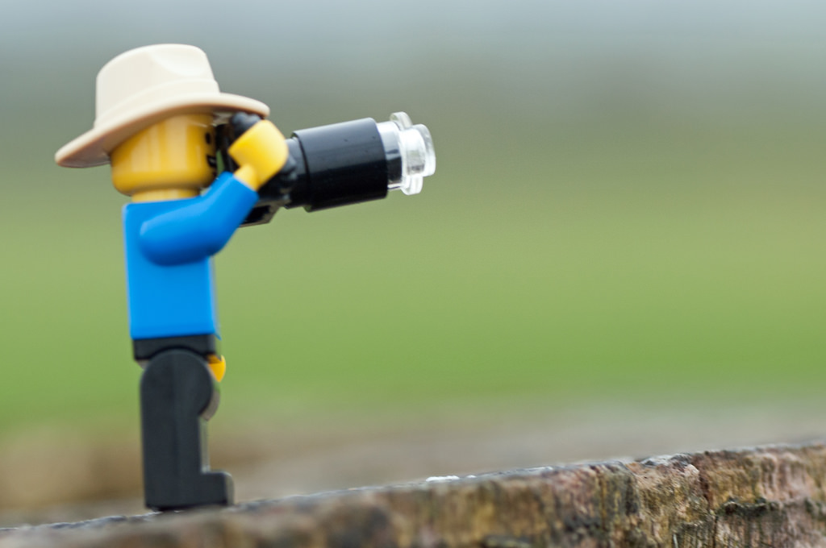
Photo CC BY-NC-SA 2.0 https://www.flickr.com/photos/gordon_mckinlay/
Notes:
It’s able to be inspected for bugs and bias.

Slide 13
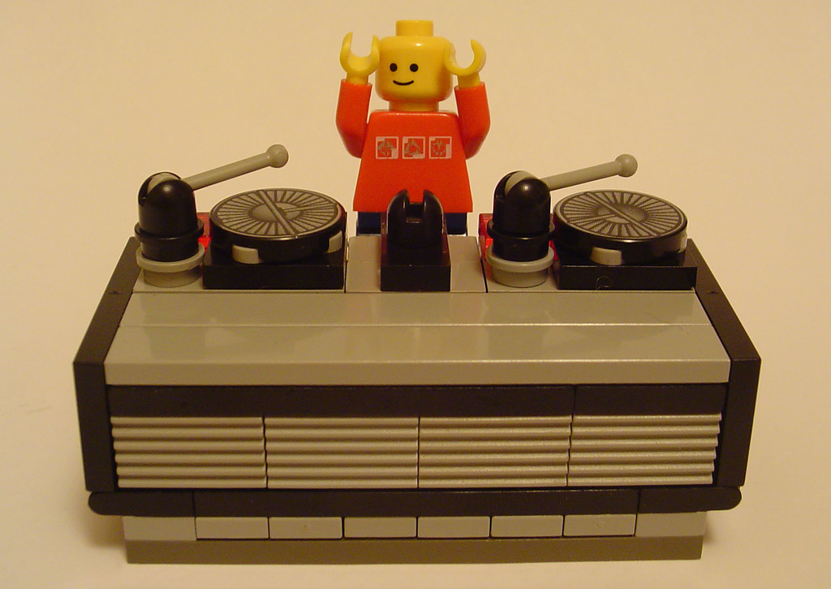
CC BY NC SA https://www.flickr.com/photos/minifig/
Notes:
Not only that, Can be remixed and reused.

Slide 14
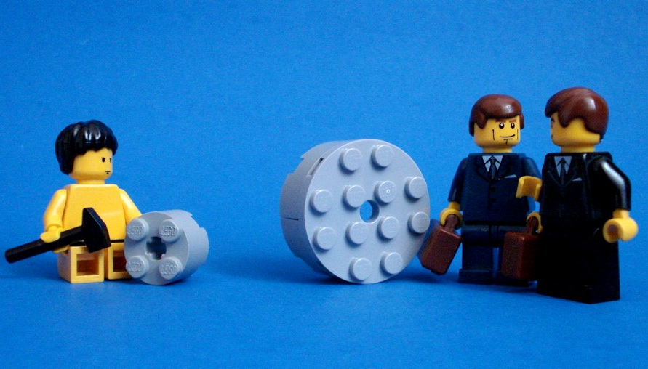
Photo CC by-nc-sa http://www.flickr.com/photos/hoyvinmayvin/
Notes:
Don’t have to reinvent the wheel. Can build upon what others have done.

Slide 15
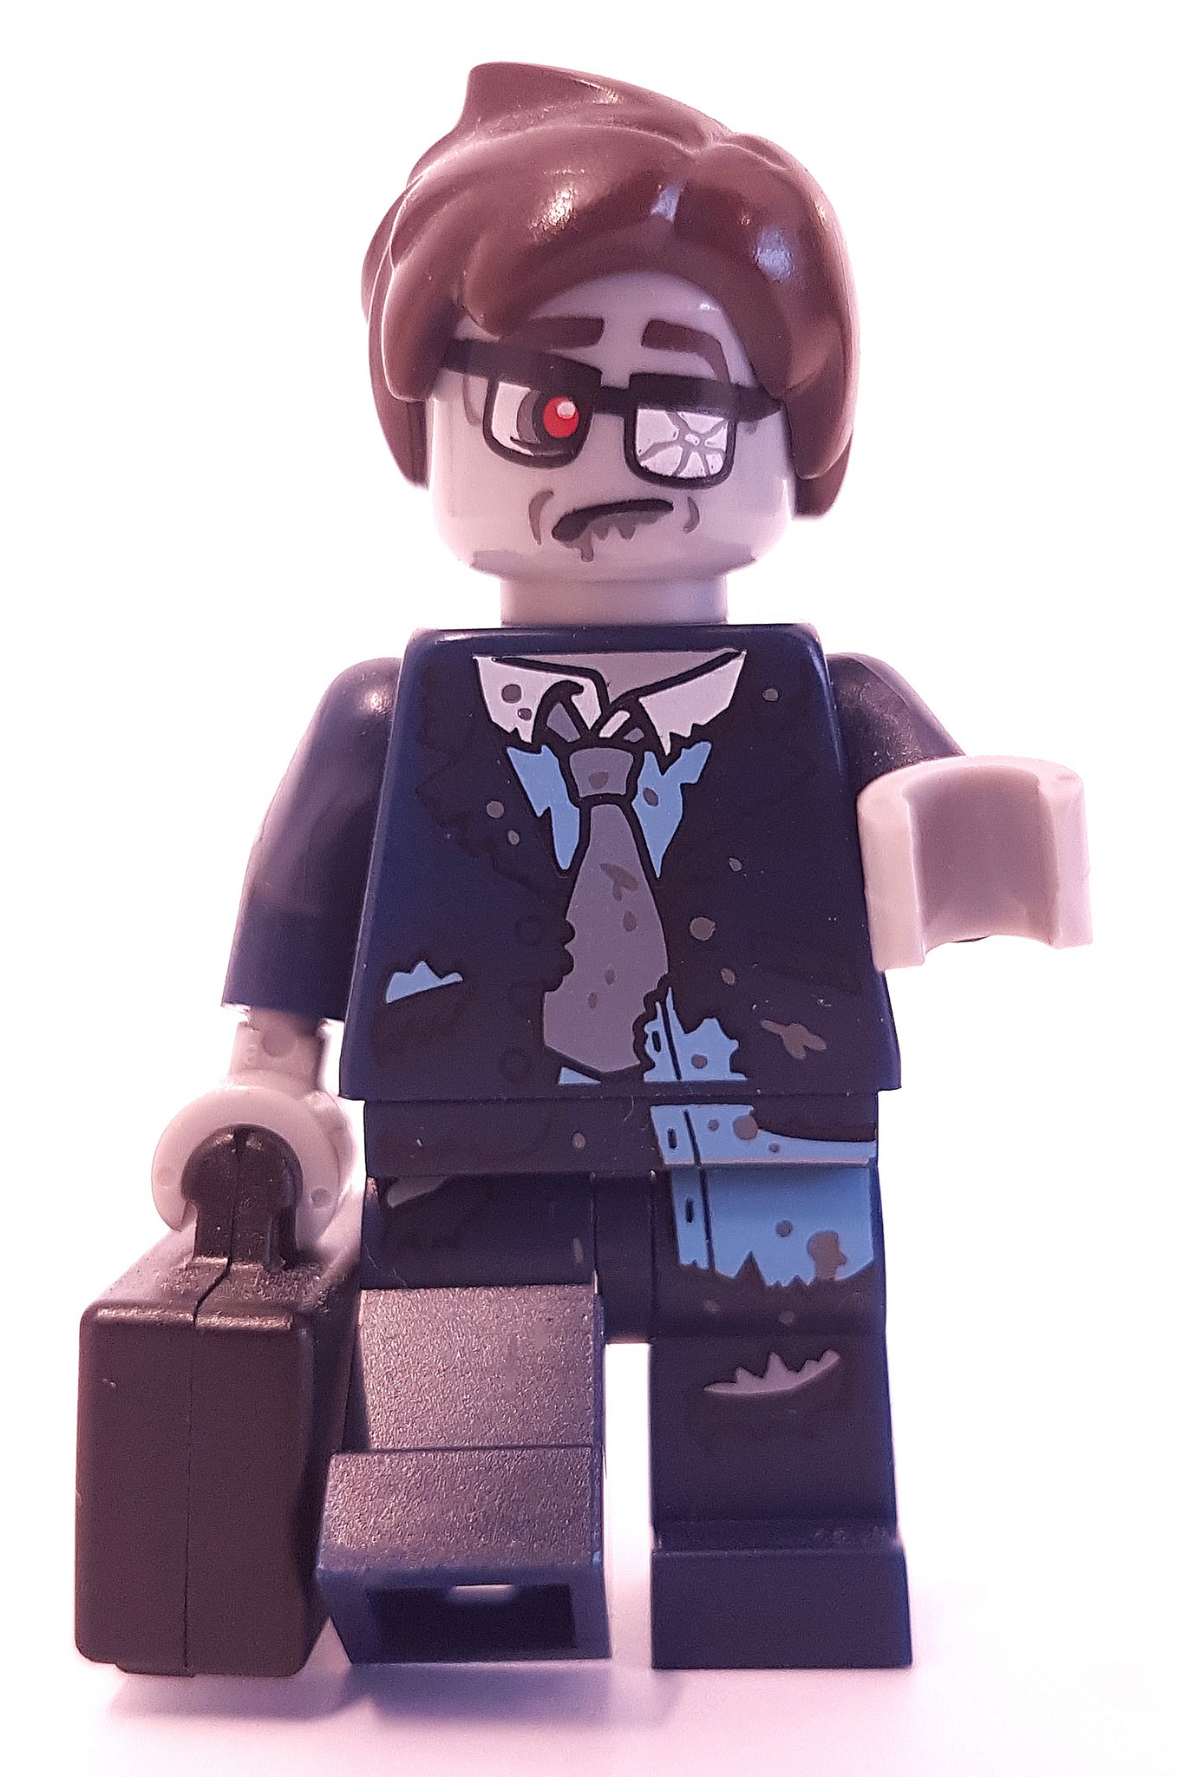
Photo CC BY-NC-SA https://www.flickr.com/photos/joachim_s_mueller/
Notes:
Allows projects to live after failure

Slide 16
What Open Is Not

Slide 17
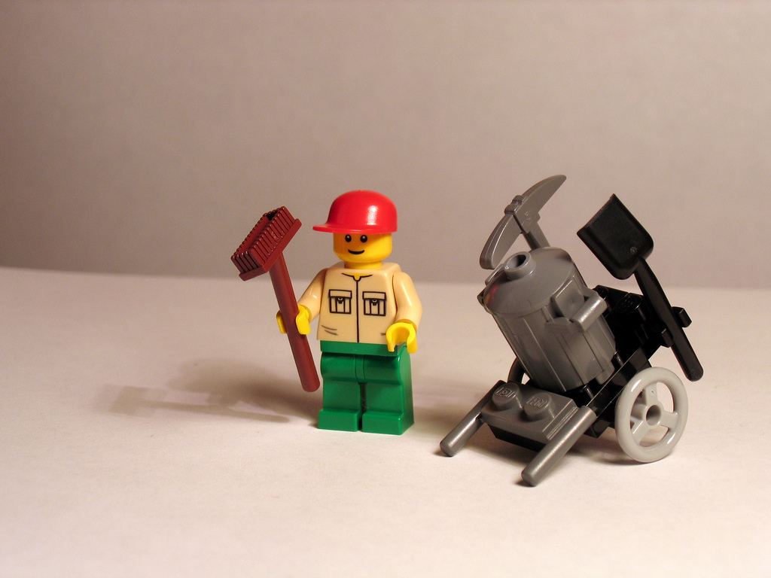
Photo CC BY SA https://www.flickr.com/photos/jreed/
Notes:
Not all garbage

Slide 18
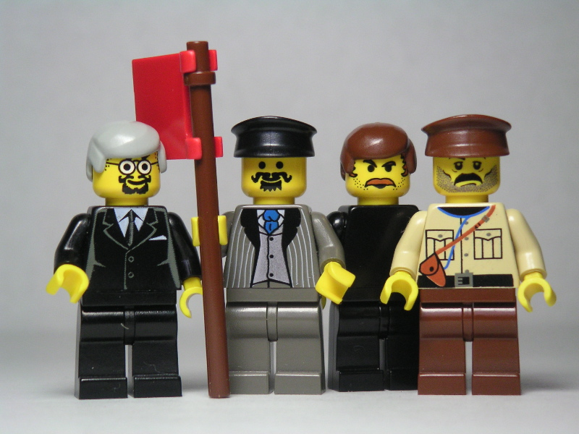
Photo CC BY-NC-SA https://www.flickr.com/photos/dunechaser
Notes:
You can maintain ownership of material that you open up.

Slide 19
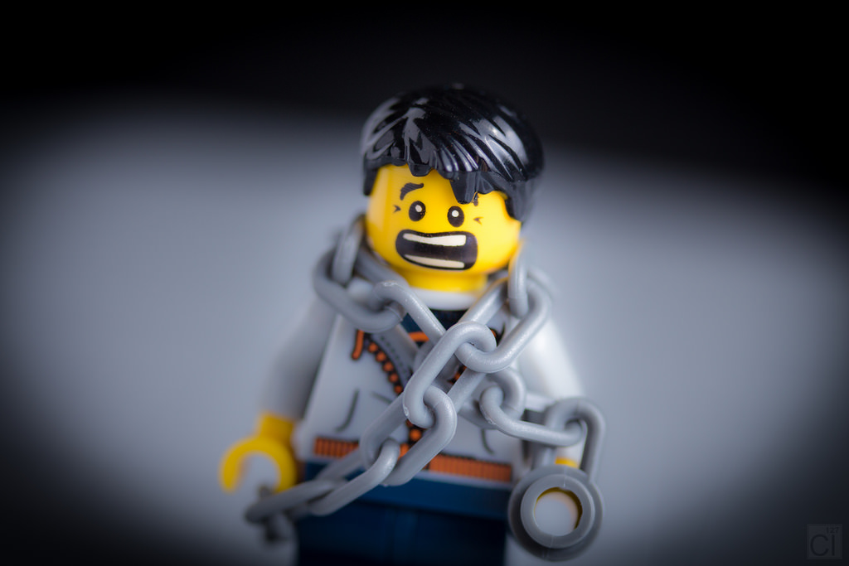
PHOTO CC BY-NC-ND https://www.flickr.com/photos/clement127/
Notes:
It’s not insecure.

Slide 20
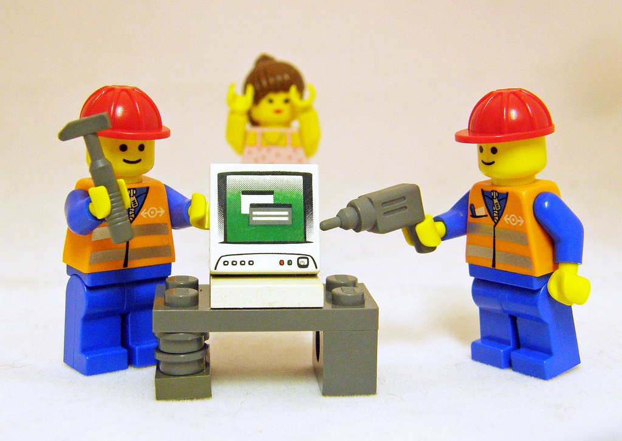
Photo CC BY-NC-SA https://www.flickr.com/photos/kaptainkobold/
Notes:
Hard to use.

Slide 21
Why Legal and Open Source are a Good Match

Slide 22
Public Interest Law and Open Source…
Believe in free access to helpful tools
Give away stuff
Benefit from the generosity of others
Are about communities
Make the world a better place
Adapted from https://www.slideshare.net/guestb4c030/open-source-applications-how-libraries-can-give-back

Slide 23
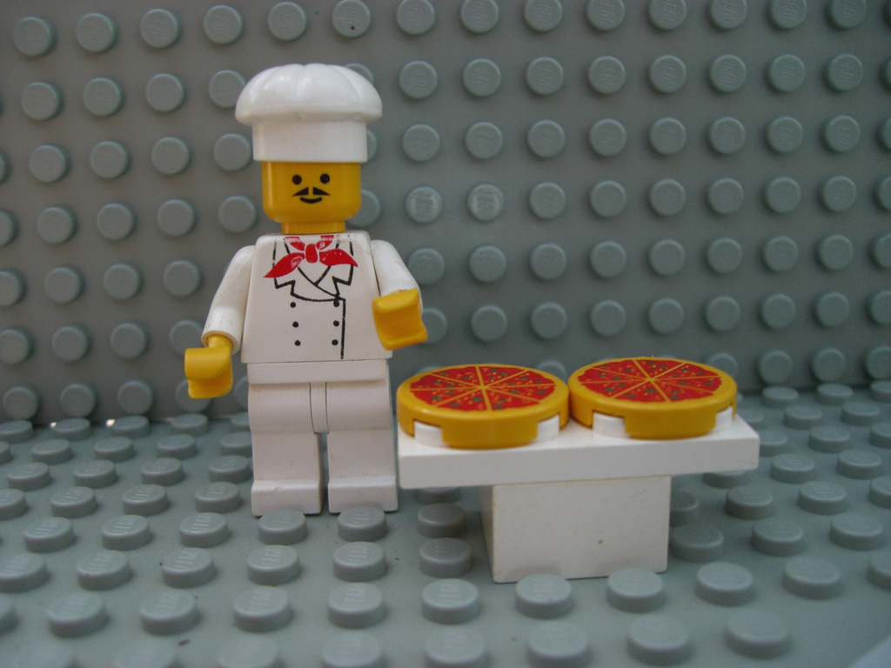
Photo CC BY-NC-SA 2.0 https://www.flickr.com/photos/39066002@N05/
Notes:
Law also has special needs and ethical rules that we could bake right in and not rely upon outside vendors to provide.

Slide 24
How do you get open?

Slide 25
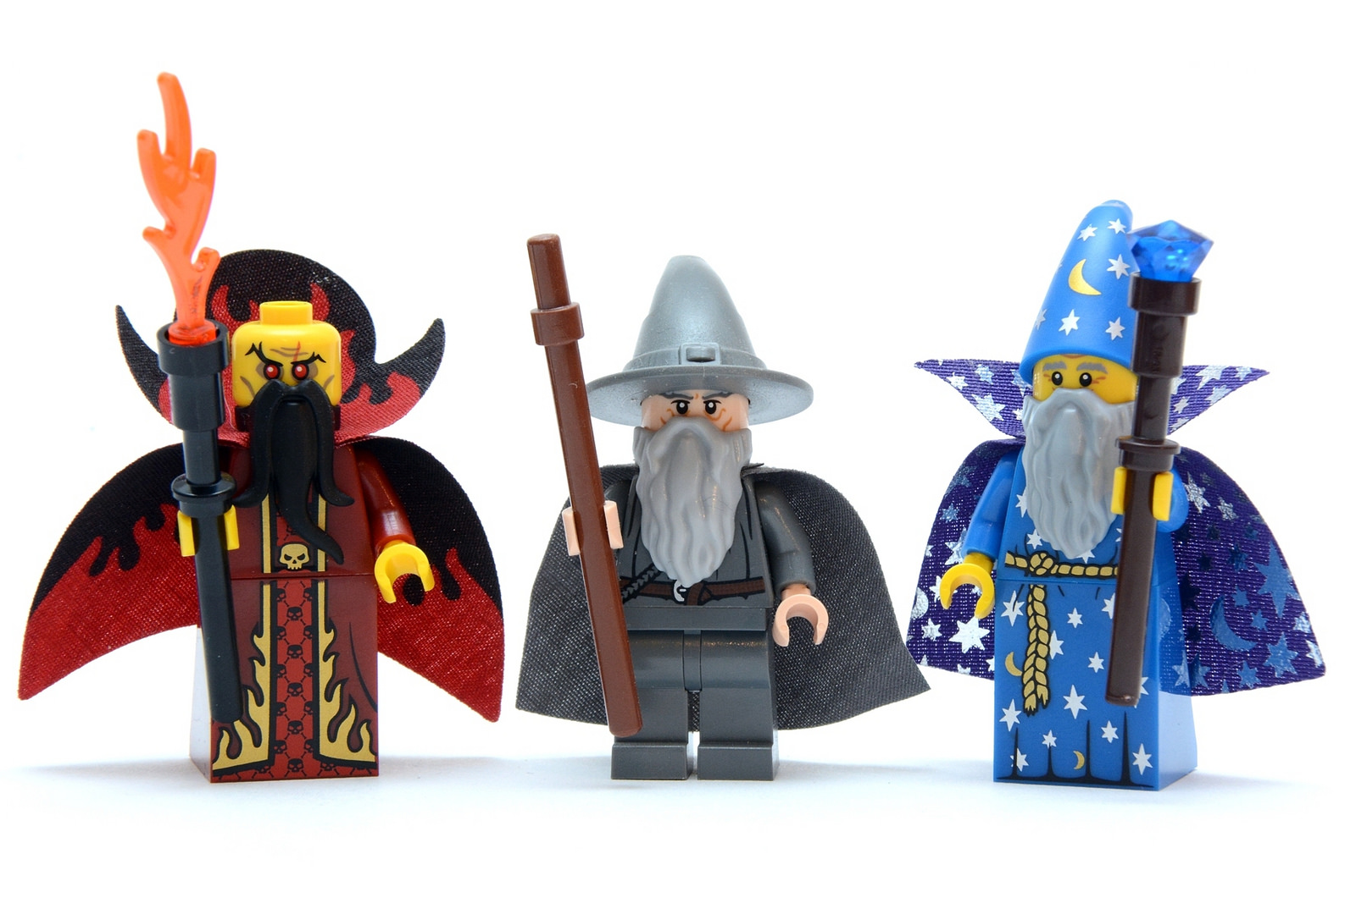
Photo CC BY-NC-SA 2.0 https://www.flickr.com/photos/joachim_s_mueller/
Notes:
It’s not quite as easy as waving a magic wand, but it’s close.

Slide 26
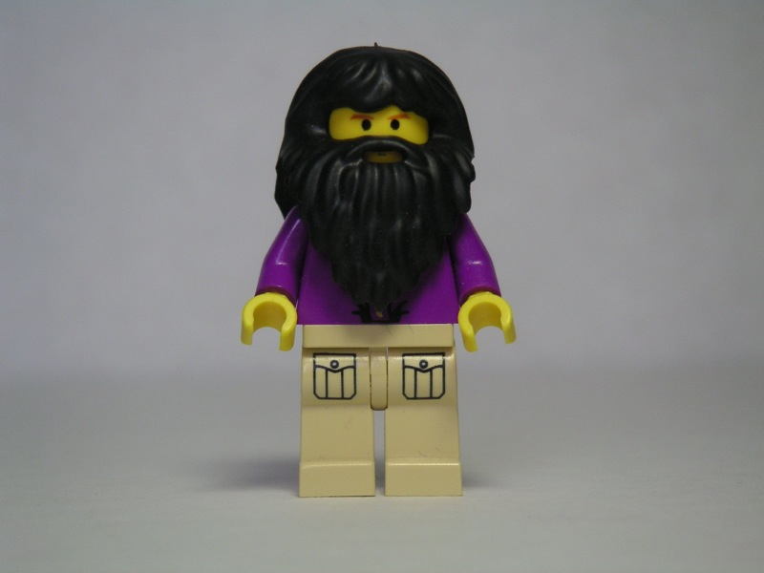
Photo CC BY-NC-SA https://www.flickr.com/photos/dunechaser/
Notes:
Richard Stallman

Slide 27
Four Freedoms
Freedom to run the program as you wish;
Freedom to study the source code of the program and then change it so the program does what you wish;
Freedom to help your neighbor. That’s the freedom to redistribute the exact copies of the software when you wish;
Freedom to contribute to your community. That’s the freedom to distribute copies or modified versions when you wish.

Slide 28
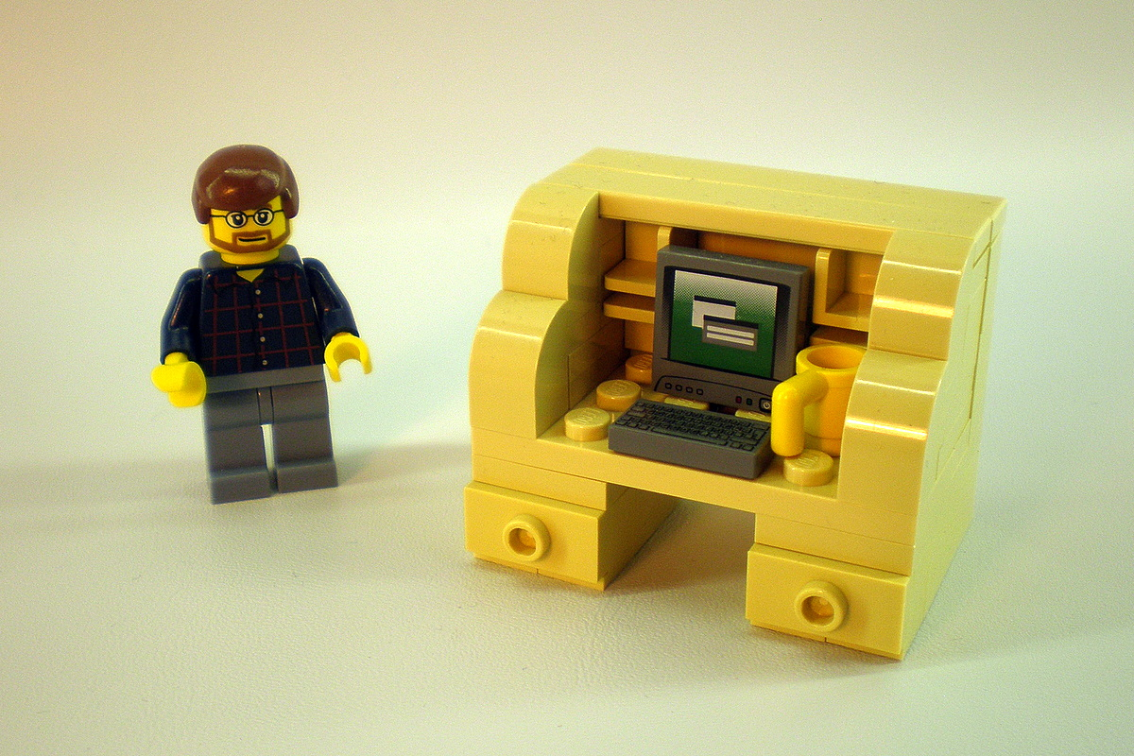
Photo CC BY-NC-SA 2.0 https://www.flickr.com/photos/legozilla/
Notes:
Need to pick a license. Under no circumstances should you try and write your own.

Slide 29
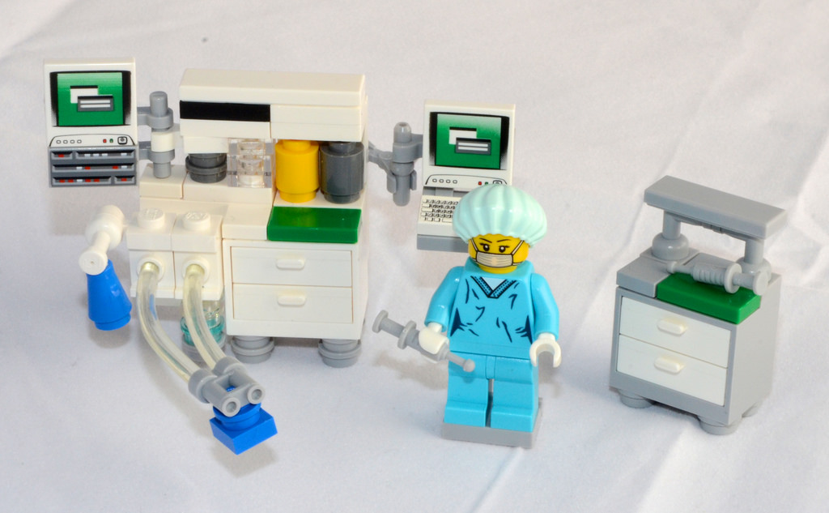
Photo CC BY-NC-ND 2.0 https://www.flickr.com/photos/luciefilteau/
Notes:
Interoperability – Can’t just mix and match licenses.

Slide 30
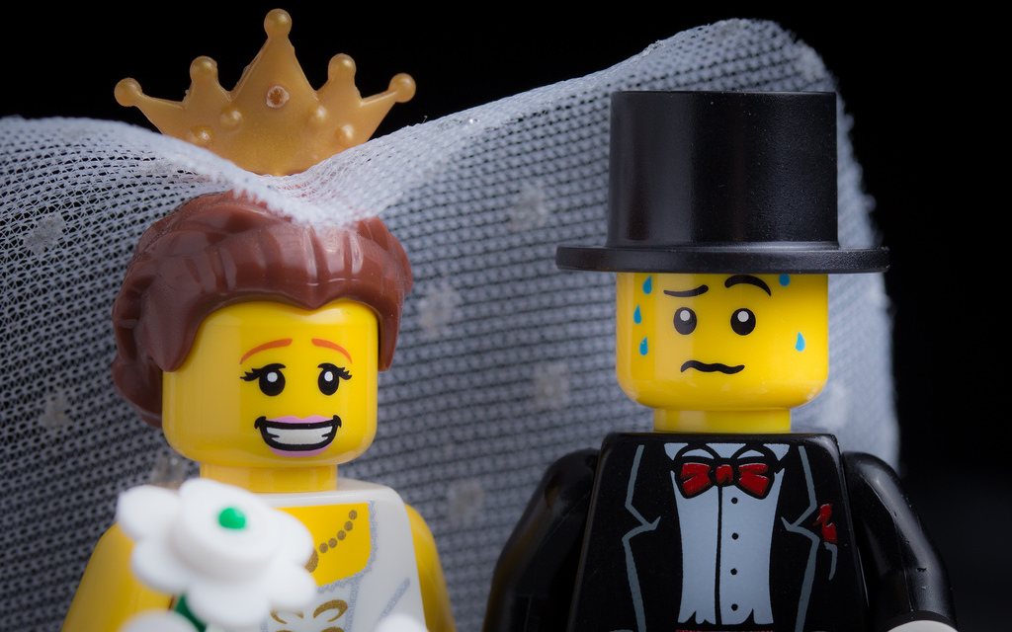
Photo CC BY-NC-ND 2.0 https://www.flickr.com/photos/clement127/
Notes:
Compatibility for GPL
You may not use GPL’ed code if you’re using something that’s GPL incompatible.

Slide 31
These are GPL Compatible Licenses
GNU General Public License (GPL) version 3
GNU General Public License (GPL) version 2
GNU Lesser General Public License (LGPL) version 3
GNU Affero General Public License (AGPL) version 3
Apache License, Version 2.0
CC0 (Creative Commons Public Domain)
X11 License (MIT License)
Mozilla Public License (MPL) version 2.0
https://www.gnu.org/licenses/license-list.html#GPLCompatibleLicenses

Slide 32
These are NOT GPL Compatible
Academic Free License, all versions through 3.0
LaTeX Project Public License 1.2
Open Software License, all versions through 3.0
https://www.gnu.org/licenses/license-list.html#GPLIncompatibleLicenses

Slide 33
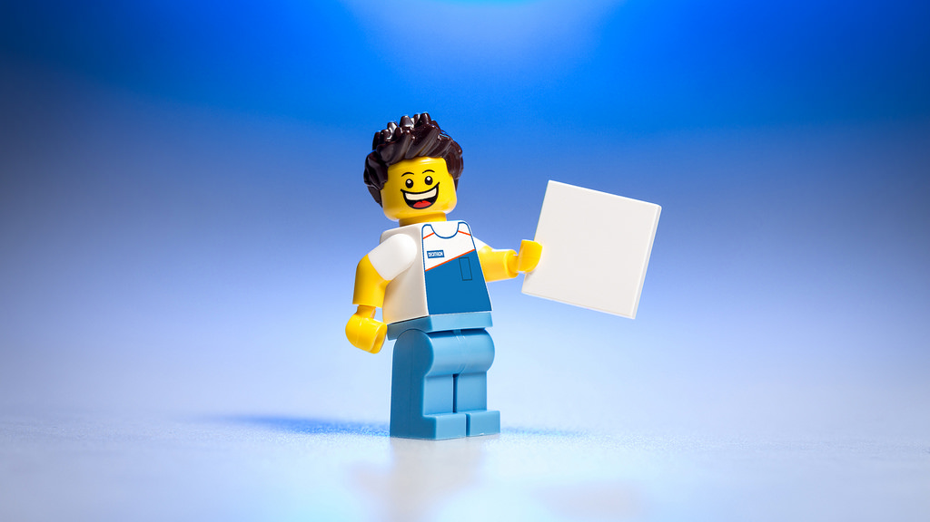
Photo CC BY NC ND https://www.flickr.com/photos/clement127/

Slide 34
License | GPL v3.0 | LGPL v3.0 | BSD | MIT (X11) | Apache v2.0
Can You Release Commercial Works? | Yes, but ALL source code must be distributed under GPL (viral). | Yes | Yes | Yes | Yes
Can You Create Derivative Works? | Yes, but ALL source code must be distributed under GPL(viral). | Yes, but any derivative software must be released under a LGPL license and allow reverse engineering for client modifications and debugging. | Yes | Yes | Yes
Attribution? | Must be included in your source code and distribution. | Must be included in your source code and distribution. | Must be included in your source code and any documentation that you include with the release of your software. | Must be included with your source code. | Must be included with your source code, and you may be required to include it in your distribution if your licensor requires.
So What? | The GPL dominates the free software world by significant margins. While it’s a favorite for those committed to the open source movement, many are shying away from it because of its viral nature which can potentially scare clients. | Not viral like it’s GPL counterpart. Software can be dynamically linked to other LGPL licensed libraries without having to release your source code under LGPL. This license is generally used for software libraries with exception of programs such as Mozilla and Open Office. | The BSD license is popular because of the flexibility it allows its licensees. There are really no limitations to what the licensee can do with the software other than the attribution requirements. | This is becoming a very popular license because of the extreme simplicity of its text. The whole license is about half a page long and is very permissive like the BSD license. | This license is somewhat similar to the BSD license, but goes into further detail in the attribution clauses and maintenance of intellectual property rights. Choosing this license over the BSD or MIT license is a matter of how specific you want your protections to be.
https://www.newmediarights.org/open_source/new_media_rights_open_source_licensing_guide

Slide 35
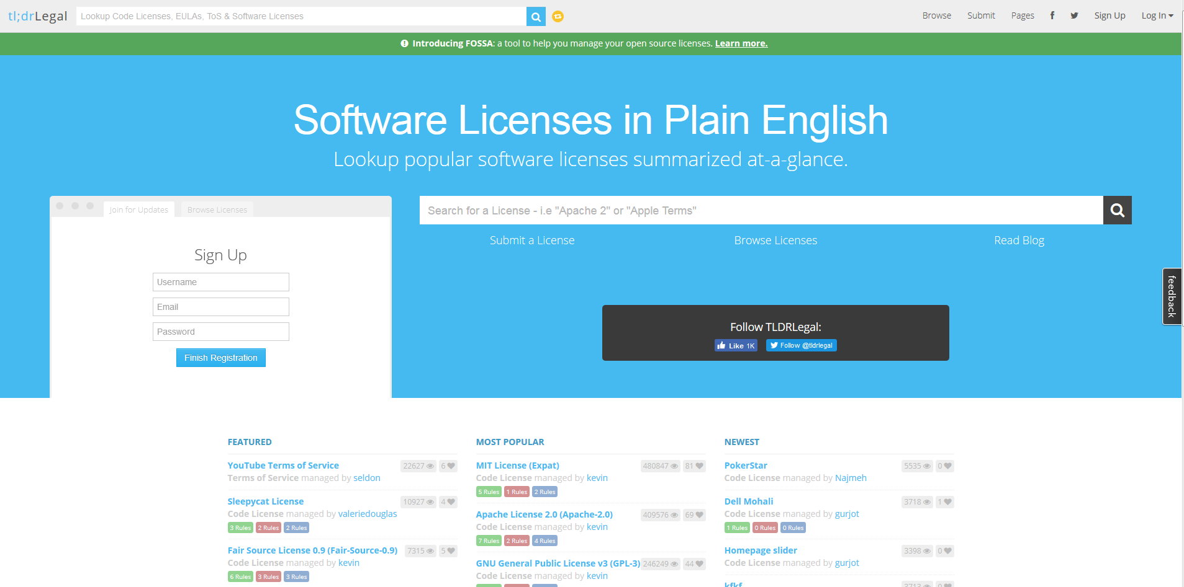
https://tldrlegal.com/

Slide 36
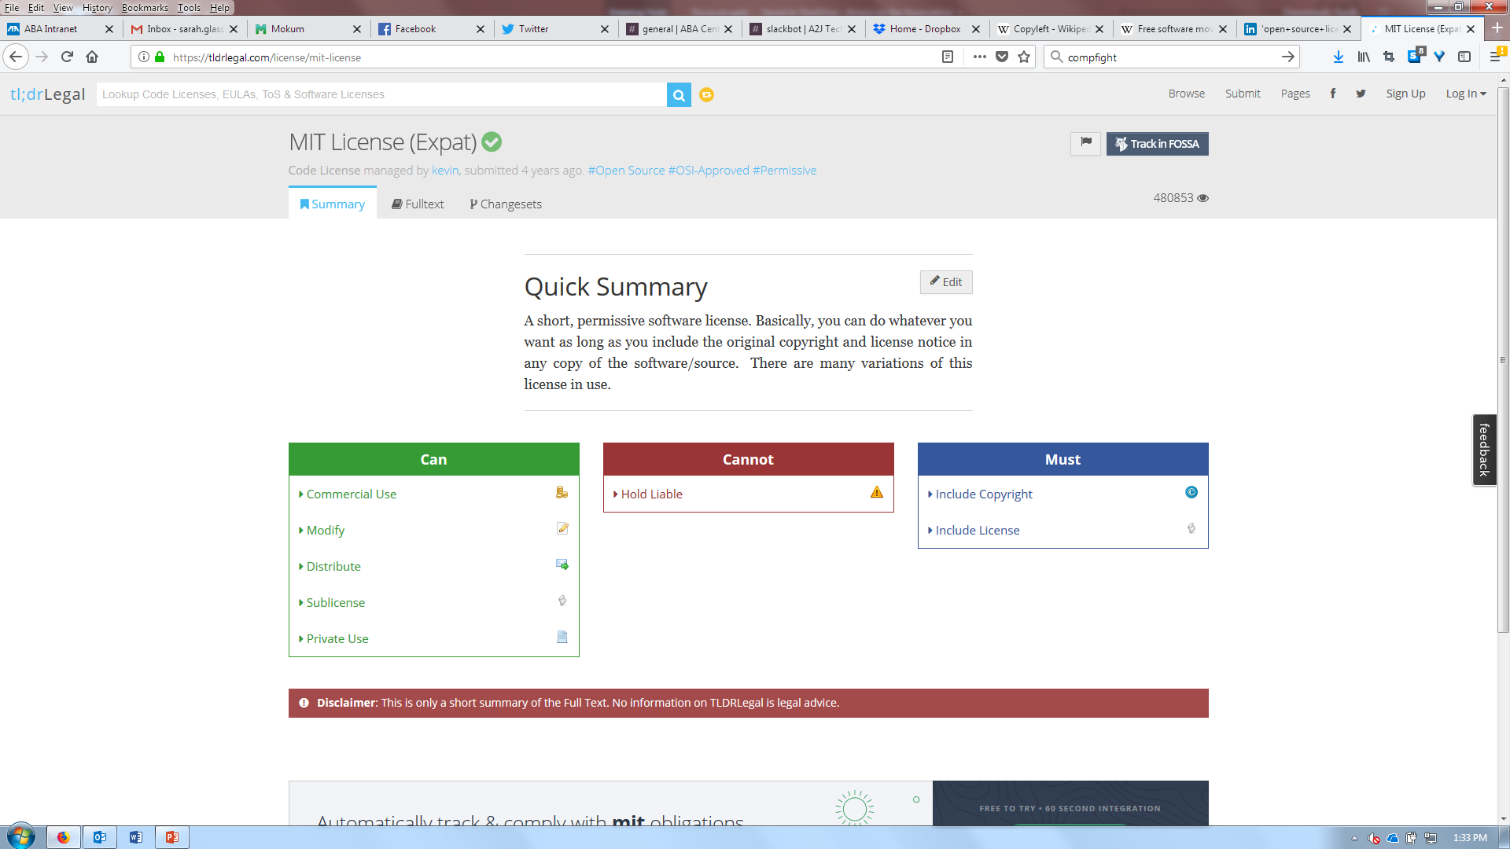

Slide 37


